Slide 1
Digital Logic Design
Chapter 6
Sequential Logic

Slide 2
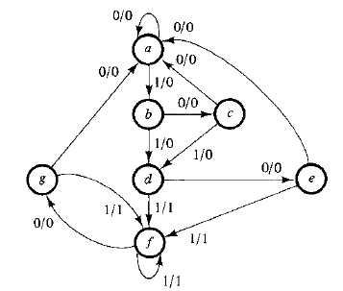

State Reduction
Any design process must consider the problem of minimizing the cost of the final circuit.
The reduction of the number of flip-flops in a sequential circuit is referred to as the state reduction.

Slide 3
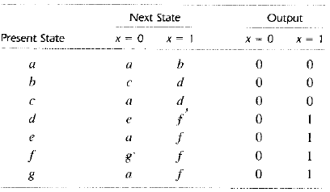
State Reduction
Two states are said to be equivalent if, for each member of the set of inputs, they give exactly the same output and send the circuit either to the same state or to an equivalent state.
One of them can be replaced by the other.

Slide 4
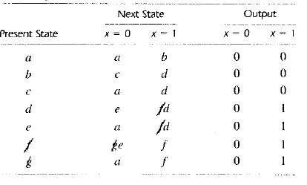
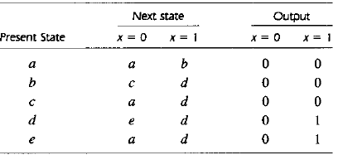
State Reduction

Slide 5

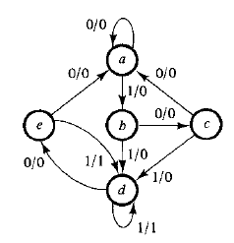
State Reduction

Slide 6
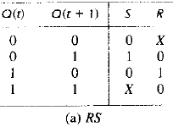
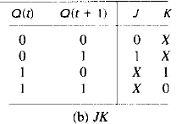
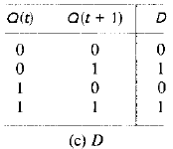
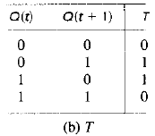
Flip-flop Excitation Tables
During the design process, we usually know the transition from present state to next state and wish to find the flip-flop input conditions that will cause the required transition.
For this reason, we need a table called an excitation table, lists the required inputs for a given change of state.

Slide 7
Design Procedure
Recommended steps are summarized:
State diagram
State table
State reduction
Binary values assignment in case above state tables contain letter symbols
Determination of number of flip-flops
Choosing the type of flip-flop
Derivation of circuit excitation and output tables
Derivation of circuit output and flip-flop input functions using k-map
Drawing the logic diagram

Slide 8
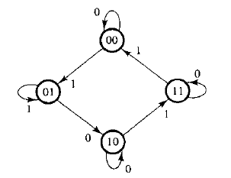
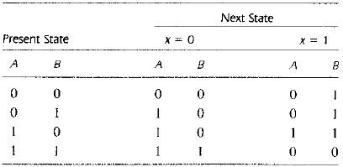
Design Procedure
We wish to design the clocked sequential circuit whose state diagram is given. JK flip-flop is to be used.

Slide 9
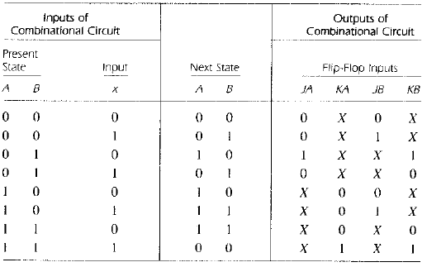
Design Procedure
As no two states are equivalent, state reduction step is not needed.

Slide 10
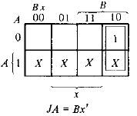
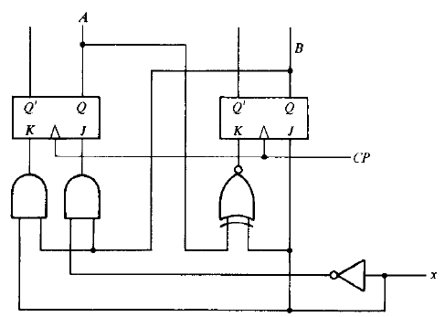
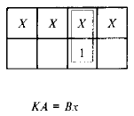
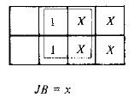
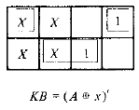
Design Procedure
Now we derive the flip-flop input functions using k-map method. Finally we draw the logic diagram.

Slide 11
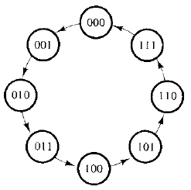
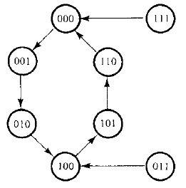
Design of Counters
A sequential circuit that goes through a prescribed sequence of states upon the application of input pulse is called a counter.
In a counter, the sequence of states may follow a binary count or any other sequence of states.

Slide 12
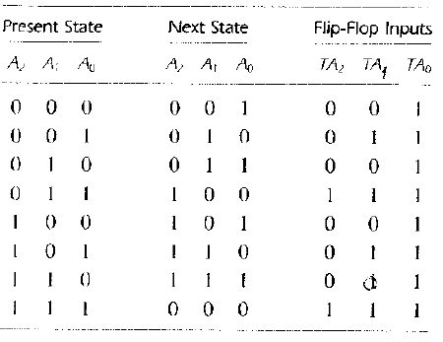
Design of 3-bit Binary Counter
The outputs are directly specified by the present states of the flip-flops.
The next state depends entirely on the present state.

Slide 13
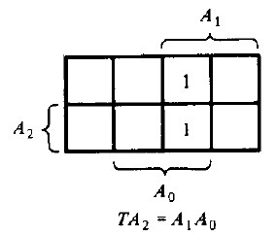
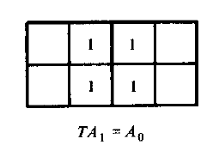
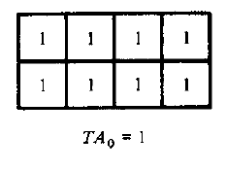
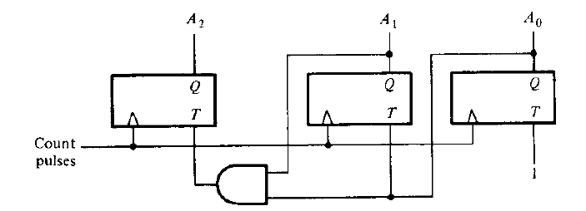
Design of 3-bit Binary Counter

Slide 14
Counter of Nonbinary Sequence
Counter may follow an arbitrary sequence that may not be the straight binary sequence.
The following is a self-correcting counter that returns to a valid state when any invalid states encounters.

Slide 15
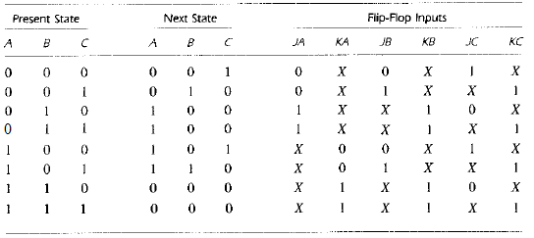
Counter of Nonbinary Sequence

Slide 16

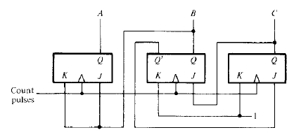
Counter of Nonbinary Sequence

Slide 17


Design with State Equations
From some given state equations we have to design the sequential circuit with D flip-flops.
The four input functions for this circuit are taken directly from the state equations, with the next state variable replaced by the flip-flop input variable.
A(t + 1) = C D
B(t + 1) = A
C(t + 1) = B
D(t + 1) = C
DA = C D
DB = A
DC = B
DD = C

Slide 18

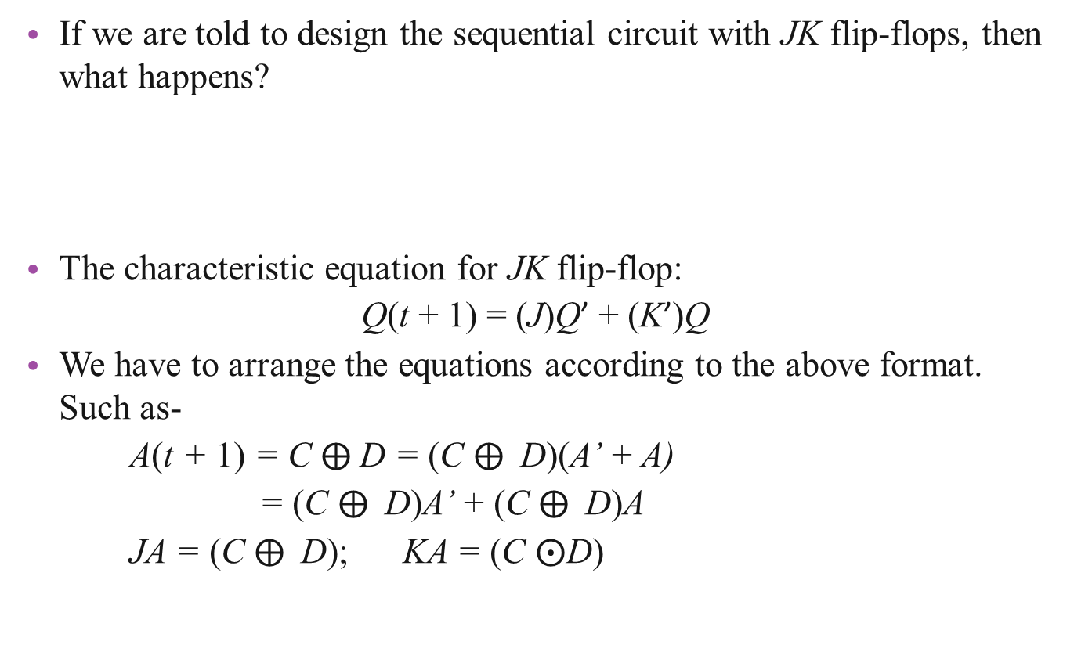
Design with State Equations
If we are told to design the sequential circuit with JK flip-flops, then what happens?
The characteristic equation for JK flip-flop:
Q(t + 1) = (J)Q’ + (K’)Q
We have to arrange the equations according to the above format. Such as-
A(t + 1) = C D = (C D)(A’ + A)
= (C D)A’ + (C D)A
JA = (C D); KA = (C $⨀$D)
A(t + 1) = C D
B(t + 1) = A
C(t + 1) = B
D(t + 1) = C

Slide 19
Design with State Equations
B(t + 1) = A = (B’ + B)A = (A)B’ + (A)B
JB = A ; KB = A’
C(t + 1) = B = (C’ + C)B = (B)C’ + (B)C
JC = B ; KC = B’
D(t + 1) = C = (D’ + D)C = (C)D’ + (C)D
JD = C ; KD = C’
Question: A sequential circuit has following equations-
Obtain the sequence of states when x = 1, starting from state ABCD = 0001
A(t + 1) = (CD’ + C’D)x + (CD + C’D’)x’;
B(t + 1) = A; C(t + 1) = B; D(t + 1) = C

